Slide 1
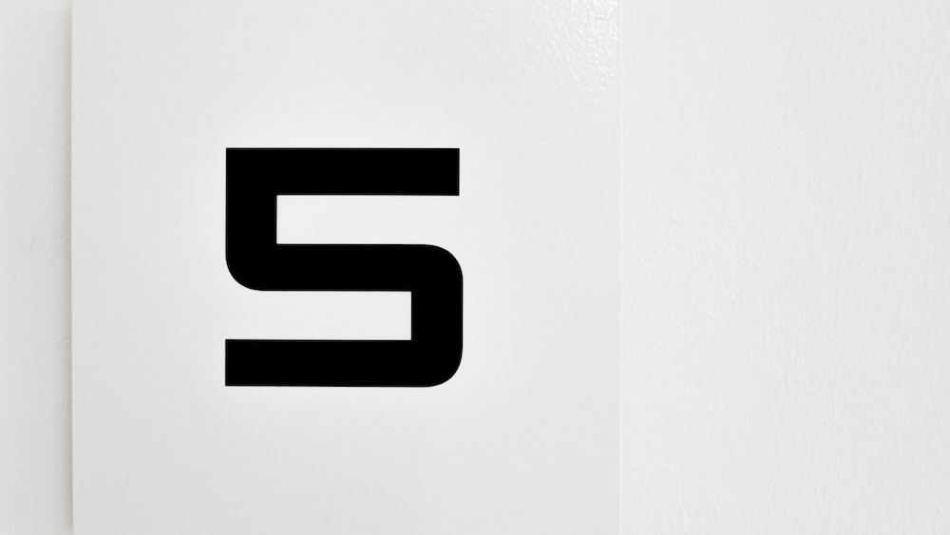

Slide 2
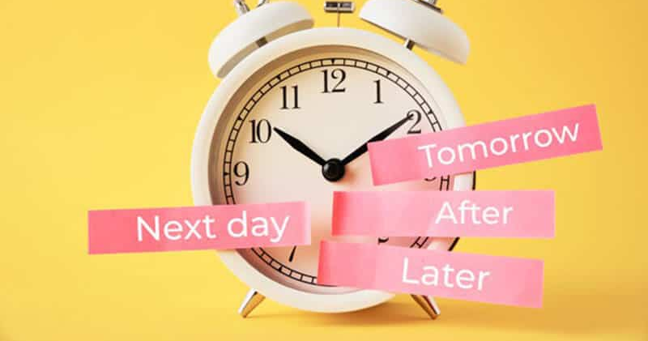

Slide 3


Slide 4


Slide 5


Slide 6


Slide 7
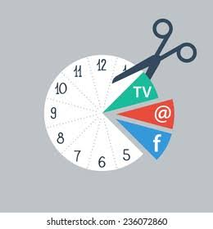

Slide 8
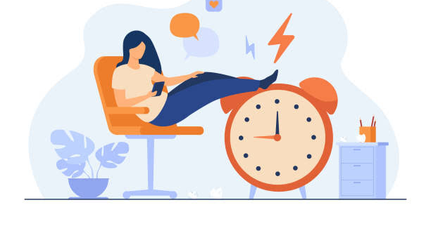

Slide 9
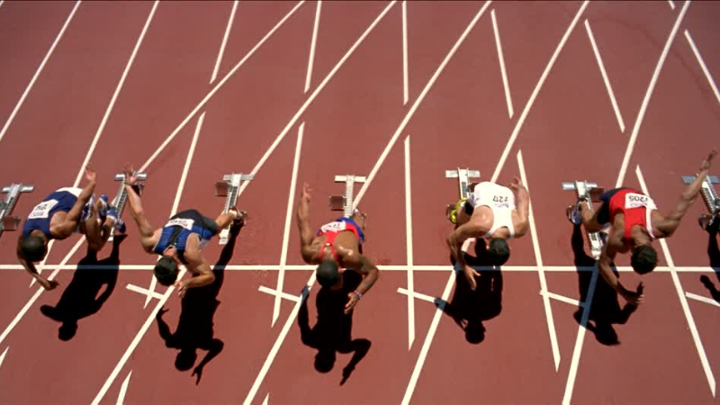

Slide 10

How to Mange your time effectively

Slide 11

Figure out how you’re currently spending your time.

Slide 12

Create a daily schedule—and stick with it.

Slide 13

Prioritize wisely.

Slide 14

Group similar tasks together.

Slide 15

Avoid the urge to multitask.

Slide 16
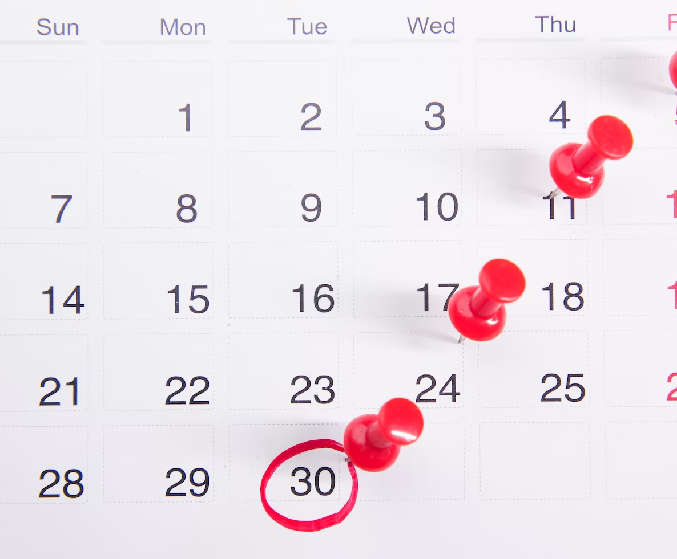
Assign time limits to tasks.

Slide 17

Build in buffers.

Slide 18

Learn to say no.

Slide 19

Get organized.

Slide 20

Eliminate distractions.

Slide 21


